Slide 1

Capstone Project on E-Commerce
ElecKart Analysis & Market Mix Model
Presented by :
Dhruval Patel | Jatin Sethi | Shreya Singh

Slide 2
Problem Statement
As a Data Scientist or an Analyst, working for ElecKart, we need to develop a market mix model based on the given information and we need to observe the actual impact of different marketing variables over the last year and recommend the optimal budget allocation for different marketing levers for the next year.

Slide 3
Summary of Business Understanding
We have consumer data that includes details of each purchase, user zip code, and order ID.
Media investment data provides information on spending across various channels such as TV and radio.
Climate data for the Ontario region is available for the years 2015 and 2016.
NPS score data offers insights into customer satisfaction, which can impact stock market prices.
A list of local holidays is provided, with the first and fifteenth of each month designated as pay dates.

Slide 4
Data Cleaning Steps
The sole purpose of data understanding and data cleaning is to deal with inconsistencies in the dataset such as missing values, exponential values present in certain fields etc. We also convert the various datatypes to a common datatype which will help us in analysis.
Converted relevant fields to datetime datatype.
Dataframes with negative values for columns like deliverybdays, deliverycdays and product procurement sla are removed/dropped.
Treated GMV values w.r.t MRP units.
Eliminating duplicate dataframes and columns
Filtered the data with 3 categories: Gaming Accessories, Camera Accessories, Home Audio Accessories
Removed few columns which does not add any value to the analysis

Slide 5
KPIs AND EXPECTED RESULTS
Gross Merchandise Value (GMV), also referred to as revenue, is the target variable we aim to maximize. To achieve this, we must identify the factors that contribute to revenue growth.
The independent variables influencing GMV include elements such as the absolute and percentage discounts on products, Net Promoter Score (NPS), and other demand drivers.
Our analysis shows that NPS, holidays, and paydates (1st and 15th of each month) have a positive impact on sales.
The next step is to determine which of the three subcategories—Gaming Accessories, Home Audio, or Camera Accessories—should be prioritized for investment in the upcoming financial year to maximize revenue growth

Slide 6
FEATURE ENGINEERING
Feature engineering involves creating new features from existing data to improve relevance and enhance the quality of analysis. In this study, the following feature engineering tasks were performed:
Time-Based Features
Created a Week column.
Updated the year for Week 53, aligning it to 2015 instead of 2016 (to match the other datasets).
Filtered data to the period July 2015 – June 2016.
Mapped months to their respective number of weeks to ensure a total of 52 weeks.
Data Cleaning & Transformation
Dropped columns containing either a single constant value or all unique values.
Created dummy variables for order_payment_type.

Slide 7
FEATURE ENGINEERING
Derived Features
Computed List Price as GMV ÷ Units.
Created a Payday flag: marked as 1 if the date was close to salary days (1st or 15th of the month), otherwise 0.
Created a Holiday flag: marked as 1 if a holiday/occasion occurred in Ontario, otherwise 0.
Defined a Product Type feature:
If GMV contribution > 80% → Premium Product
Else → Mass Market.
Generated Special Sales flag: assigned 0 for nulls and 1 for event dates.

Slide 8
FEATURE ENGINEERING
Marketing & External Factors
Calculated Marketing Spend % relative to GMV.
Imported product list from the file “Media Data and Other Information”.
Calculated 8-week Exponential Moving Average (EMA) for all advertising media channels.
Calculated 5-week and 3-week Simple Moving Averages (SMA) for advertising media channels, NPS, and Stock Index.
Created new features for Net Promoter Score (NPS) (proxy for customer sentiment) and Stock Index (external market influence).

Slide 9
Steps and Visualization

Slide 10
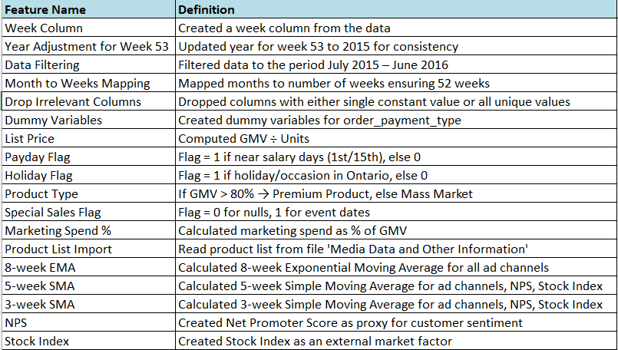
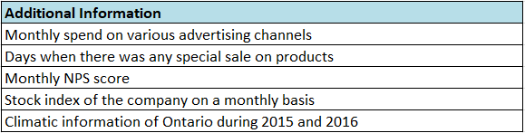
DATA UNDERSTANDING -I July 2015 to June 2016

Slide 11
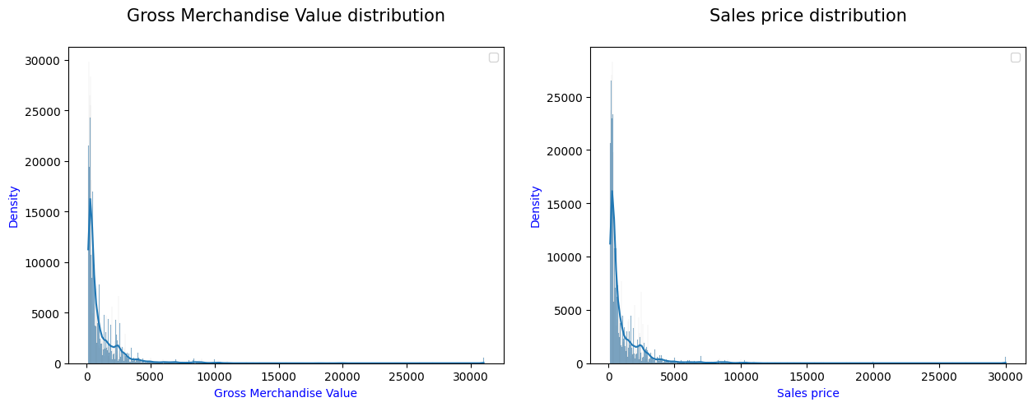
EXPLORATORY DATA ANALYSIS
The sales price and GMV distribution appears to be peaking between 0 and 5000,
with a right-skewed distribution

Slide 12
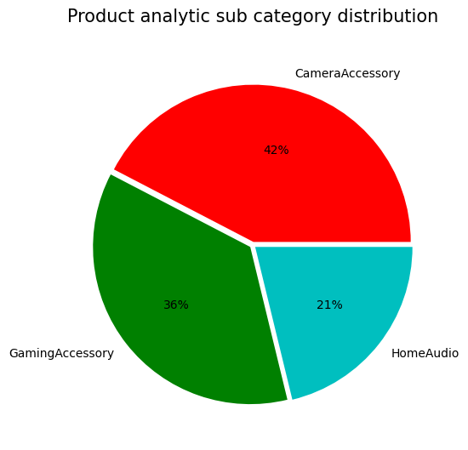
EXPLORATORY DATA ANALYSIS
The dominator is CameraAccessory at 42%,
followed by GamingAccessory at 36%,
and HomeAudio comes last at 21%

Slide 13
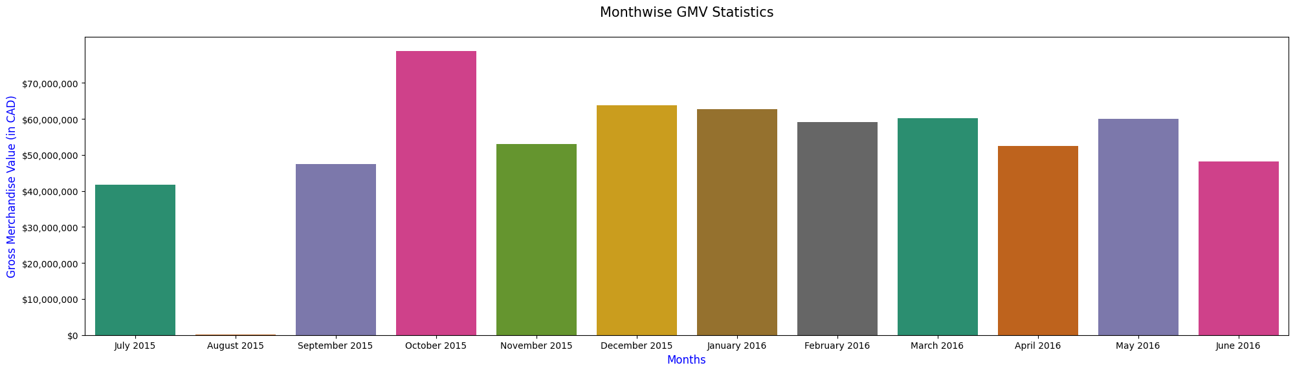
EXPLORATORY DATA ANALYSIS
The highest GMV is seen in October and December, which makes sense as they are holiday months
(Thanksgiving in Oct and Christmas in Dec).
The lowest GMV is seen in August

Slide 14
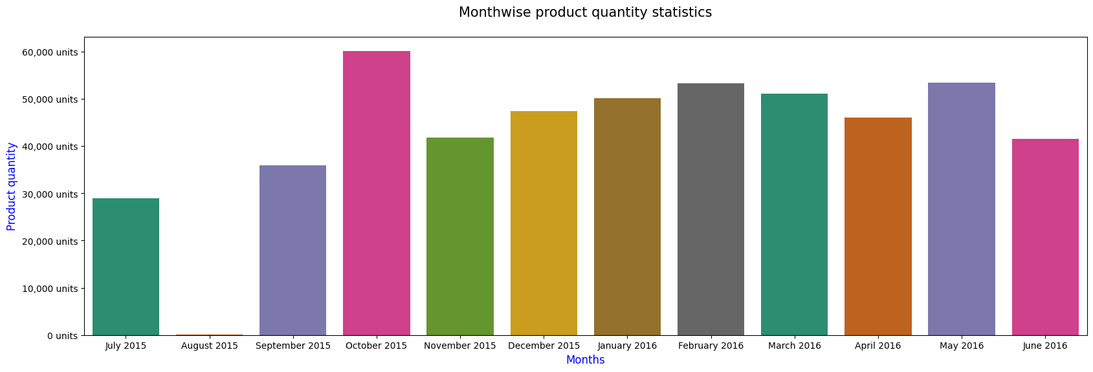
EXPLORATORY DATA ANALYSIS
Sales peaked in October, February, and May due to special sales during those months
August recorded the lowest sales overall

Slide 15
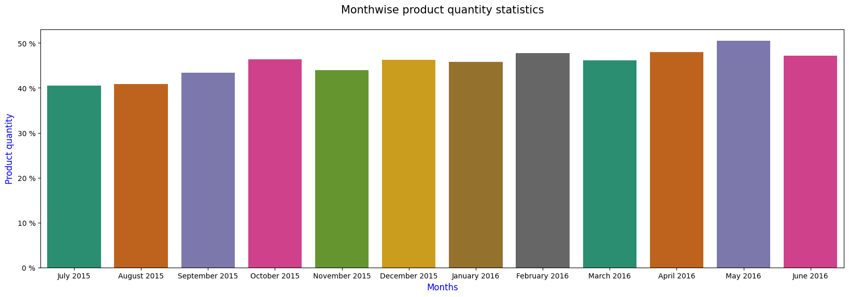
EXPLORATORY DATA ANALYSIS
April, May, and June saw the highest discounts. Products have a discount of 40-60%

Slide 16
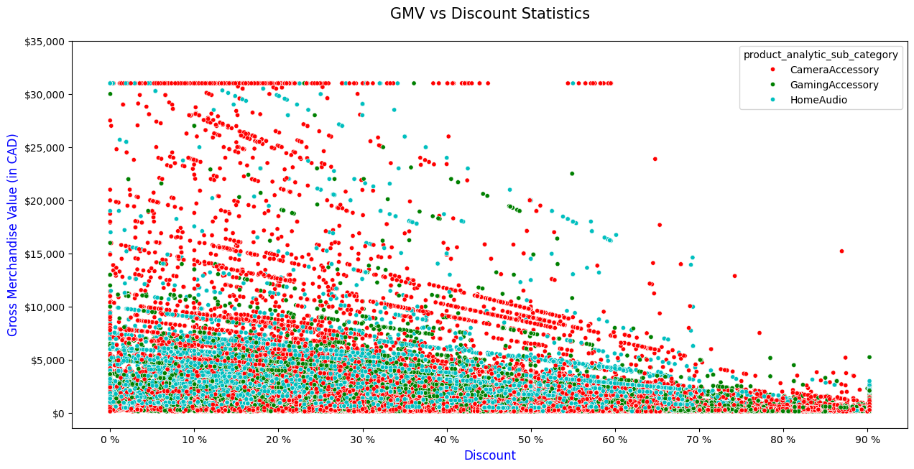
EXPLORATORY DATA ANALYSIS
GMV is highest when discounts range between 0% and 60%, but starts to decline beyond 60%
Discounted product g,v falls within 0 to CAD 15,000

Slide 17
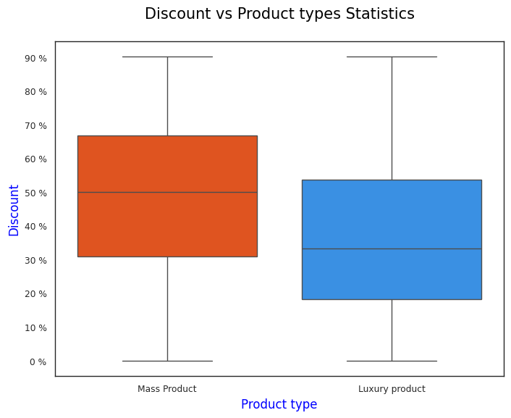
EXPLORATORY DATA ANALYSIS
Mass-market items generally receive higher discounts compared to luxury goods
Most mass products are discounted up to 50%, while luxury items typically see discounts up to 40%

Slide 18
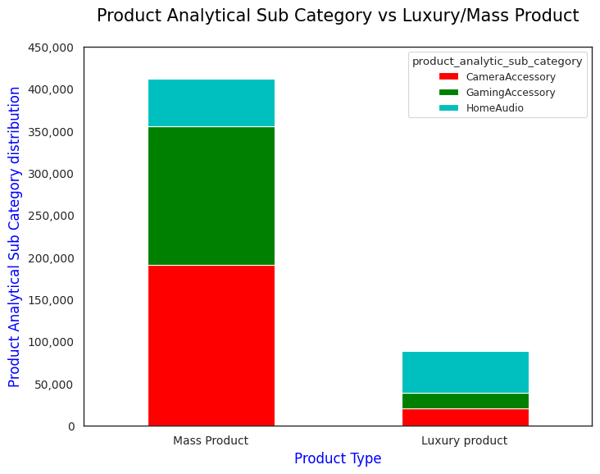
EXPLORATORY DATA ANALYSIS
Mass products receive significantly more orders compared to luxury products
Within mass products, camera accessories lead, while home audio dominates in luxury

Slide 19
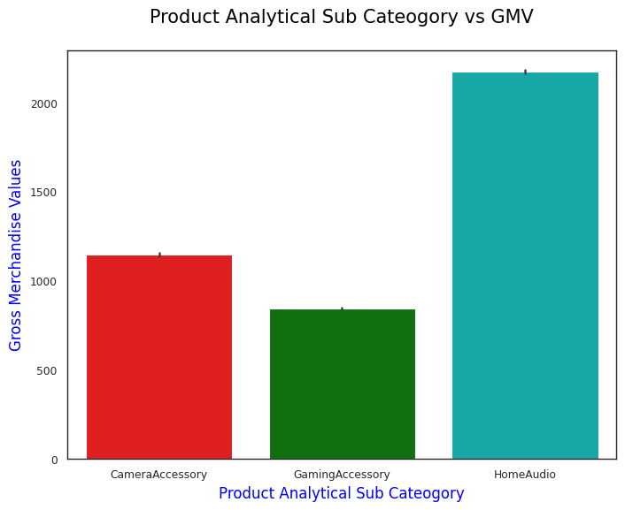
EXPLORATORY DATA ANALYSIS
Home Audio products contribute significantly more revenue compared to Camera and Gaming accessories

Slide 20
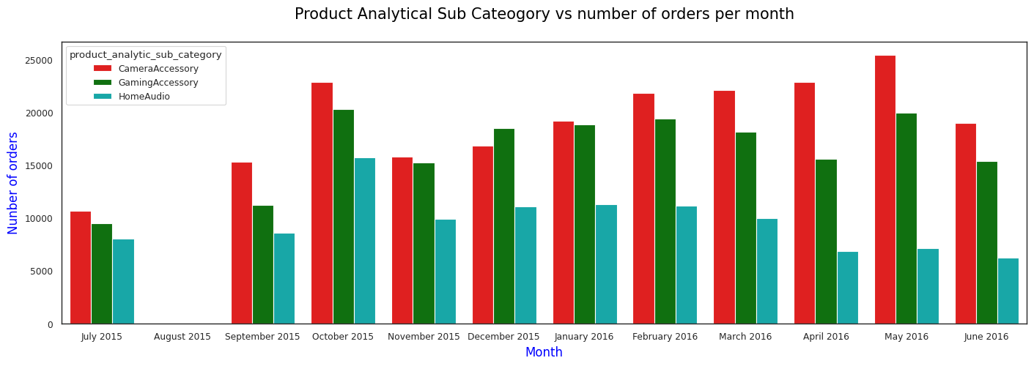
EXPLORATORY DATA ANALYSIS
Throughout most months, Camera and Gaming accessories are seen to receive more orders than Home Audio
Gaming products peak in December, surpassing the other categories
Home Audio sees notably low order volumes during April, May, and June
Orders for Camera accessories are at their highest in May and October

Slide 21
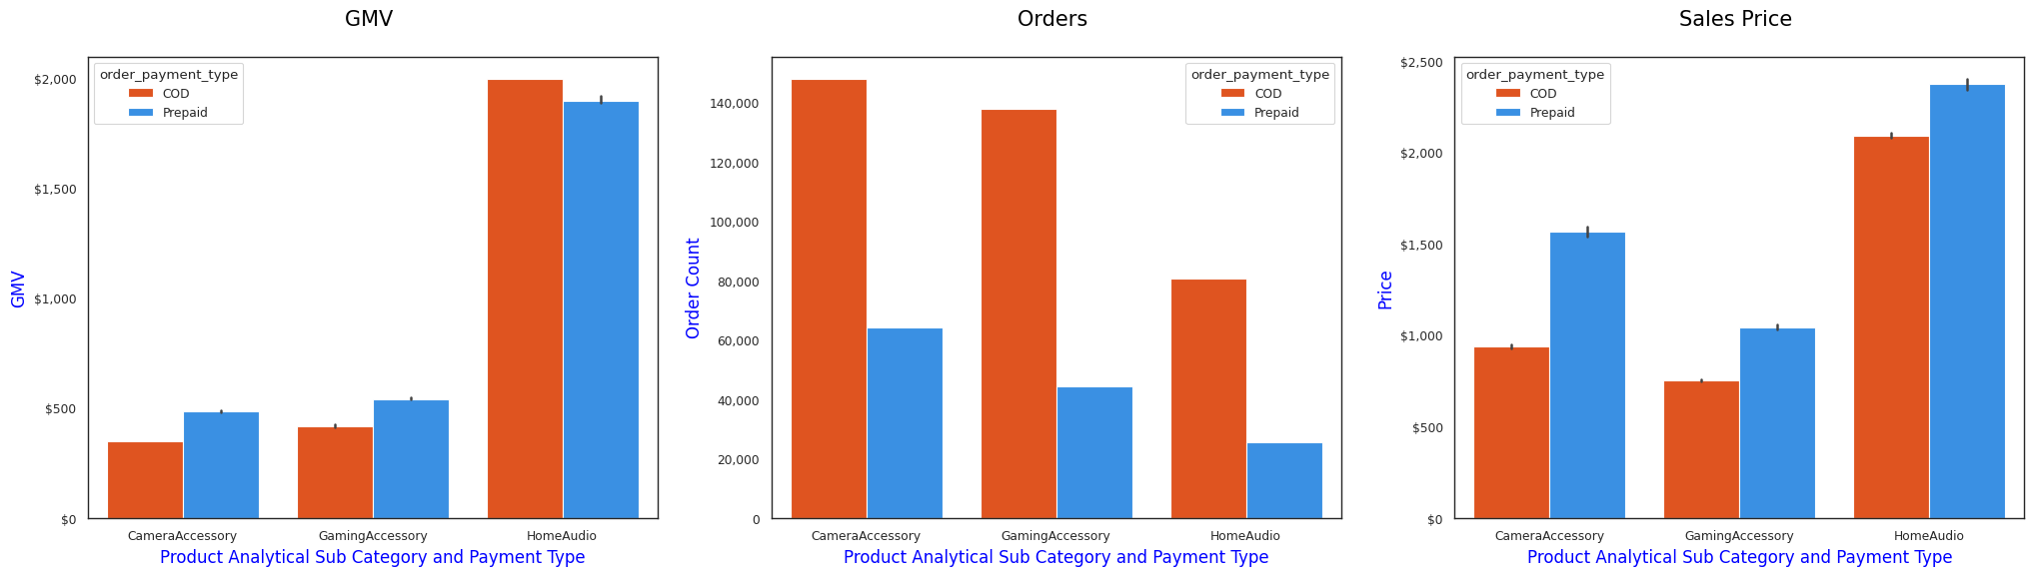
EXPLORATORY DATA ANALYSIS
Camera and gaming accessories see higher sales volume
Home Audio generates the most revenue, likely due to luxury product focus and preference for
cash on delivery
Prepaid orders bring in more revenue in Camera and Gaming
Overall, COD orders outnumber prepaid across all three categories
Prepaid orders tend to be priced higher than COD ones in every subcategory

Slide 22
MARKET MIX MODELS
We will implement and assess the following models:
1. Additive approach
2. Multiplicative approach
3. Koyck transformation model
4. Additive Distributed Lag model
5. Multiplicative Distributed Lag model

Slide 23
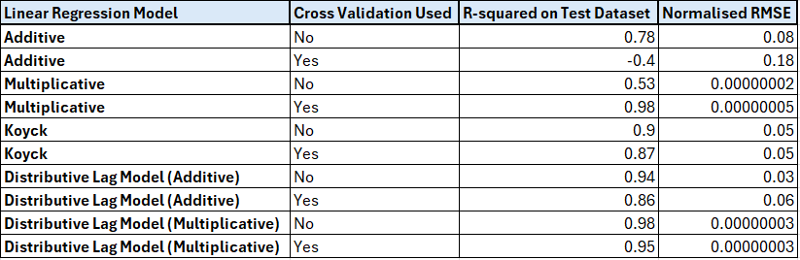
MARKET MIX MODELS Camera Accessories: Linear Regression Model Performance
For the Camera Accessories category, the Multiplicative Model with cross-validation delivers the
most accurate predictions among all tested models
Below are the key performance metrics that support this selection

Slide 24
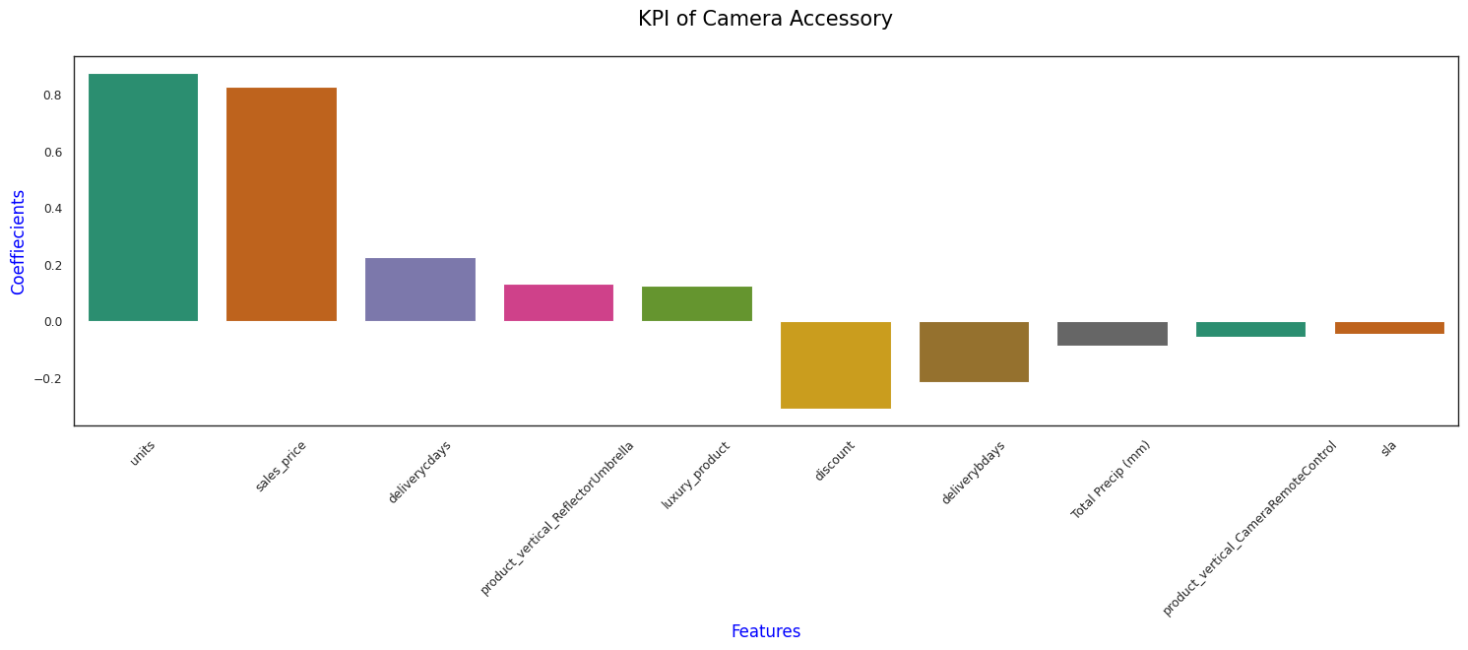
MARKET MIX MODELS Camera Accessories: Linear Regression Model Performance

Slide 25
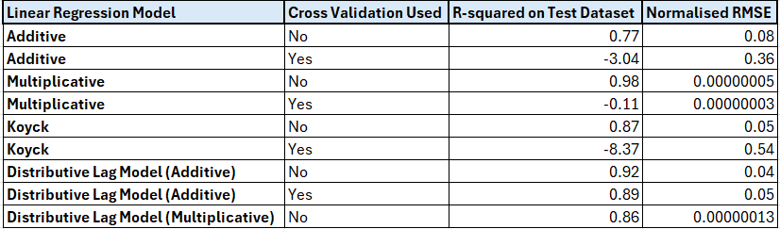
MARKET MIX MODELS Gaming Accessories: Linear Regression Model Performance
For Gaming Accessory category, Multiplicative Model stands out with highest prediction accuracy.
Let's check key performance metrics.

Slide 26
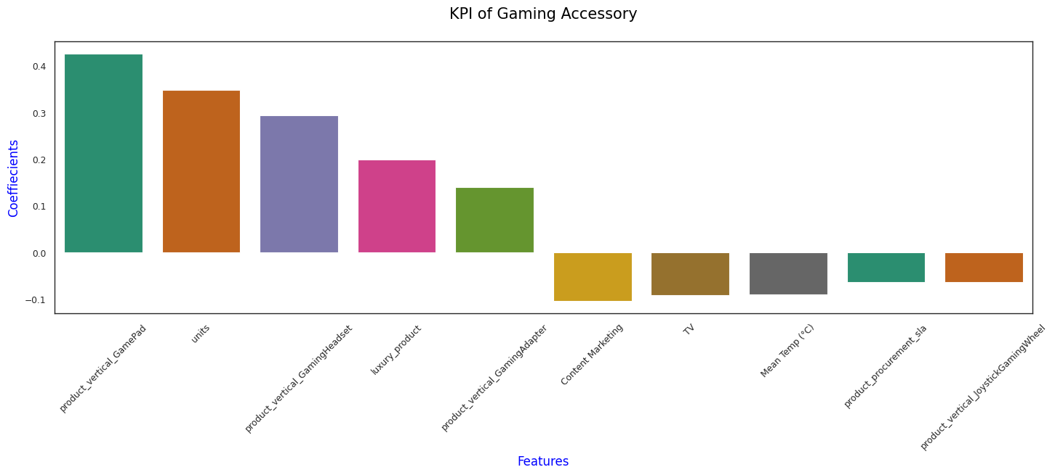
MARKET MIX MODELS Gaming Accessories: Linear Regression Model Performance

Slide 27
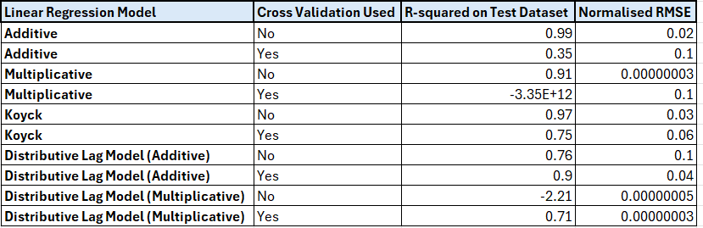
MARKET MIX MODELS Home Audio: Linear Regression Model Performance
For home audio, we can go ahead with the Additive Model due to its relatively stronger prediction performance
Below are the main evaluation metrics for this model

Slide 28
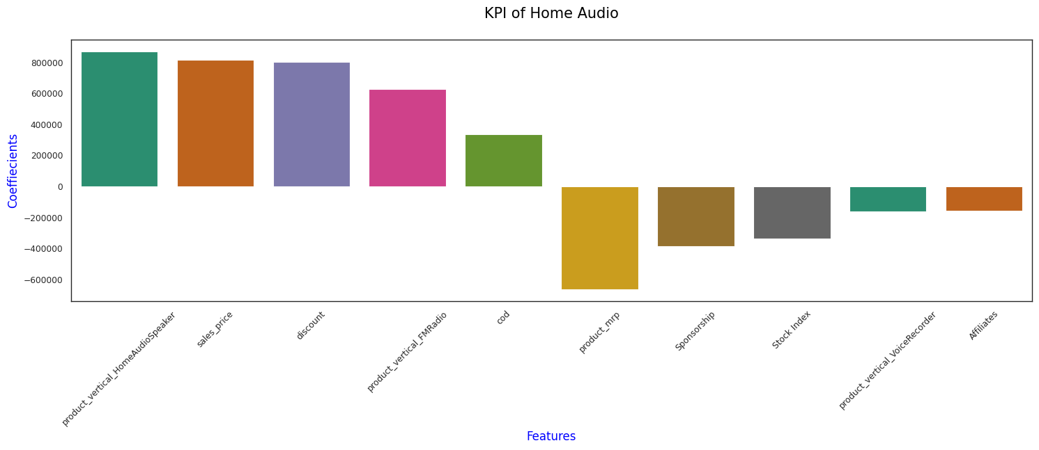
MARKET MIX MODELS Home Audio: Linear Regression Model Performance

Slide 29
MARKET MIX MODELS
Based on the regression results:
Camera and Gaming Accessories exhibit interaction effects between their key performance indicators (KPIs)
For Home Audio, the KPIs contribute additively to the Gross Merchandise Value (GMV)
The multiplicative models highlight the compounded impact of KPI changes on revenue growth.

Slide 30
CONCLUSION
Camera Accessories
Focus on premium SKUs (>2,000 CAD) with consistent stock & targeted promos.
Optimize regional inventory to cut delivery delays.
Use weather-based discounts during low-demand rainy periods.
Gaming Accessories
Prioritize top SKUs (gamepads, headsets, adapters, high-end gear).
Leverage colder months with premium pricing & bundles.
Shift spend from low-ROI TV/content ads to performance-driven digital.
Home Audio
Strengthen COD logistics to boost conversions.
Invest in high performers (speakers, FM radios); scale back low performers (voice recorders).
Reevaluate underperforming affiliates & sponsorships.

Slide 31
THANKYOU

